Slide 1
Understanding Hyperledger Fabric
By Vipin Rathi

Slide 2
Bitcoin
Script is a Forth-like
Stack-based
Reverse-polish
Turing Incomplete language.

Slide 3
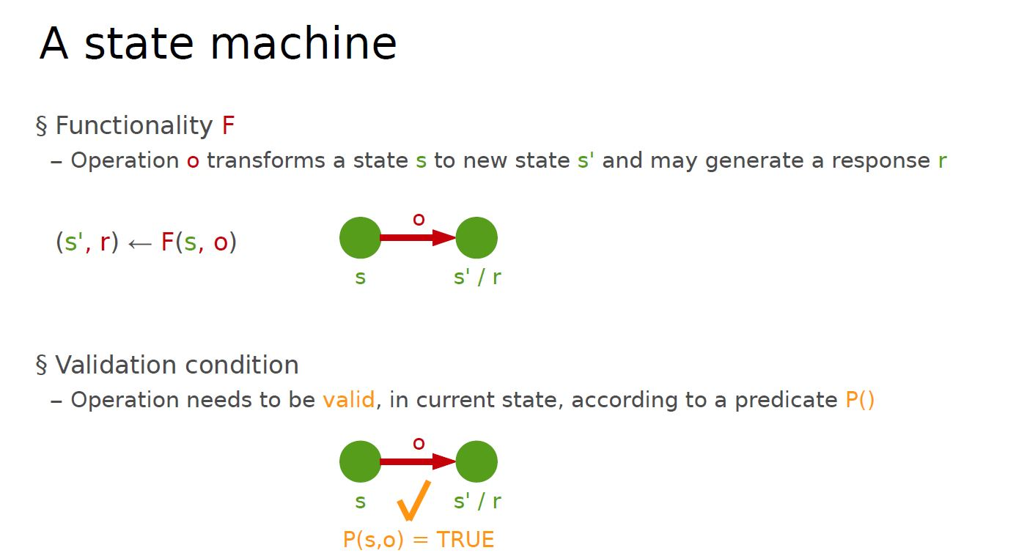

Slide 4
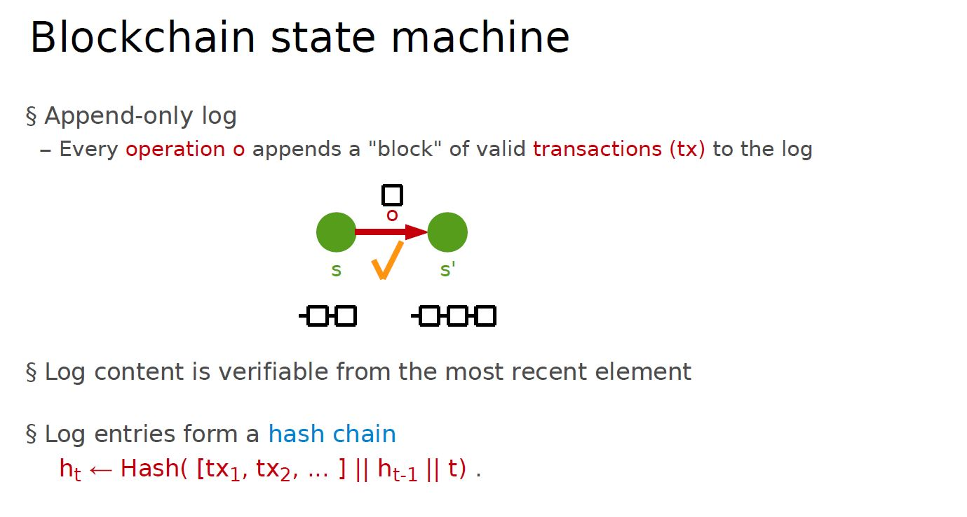

Slide 5
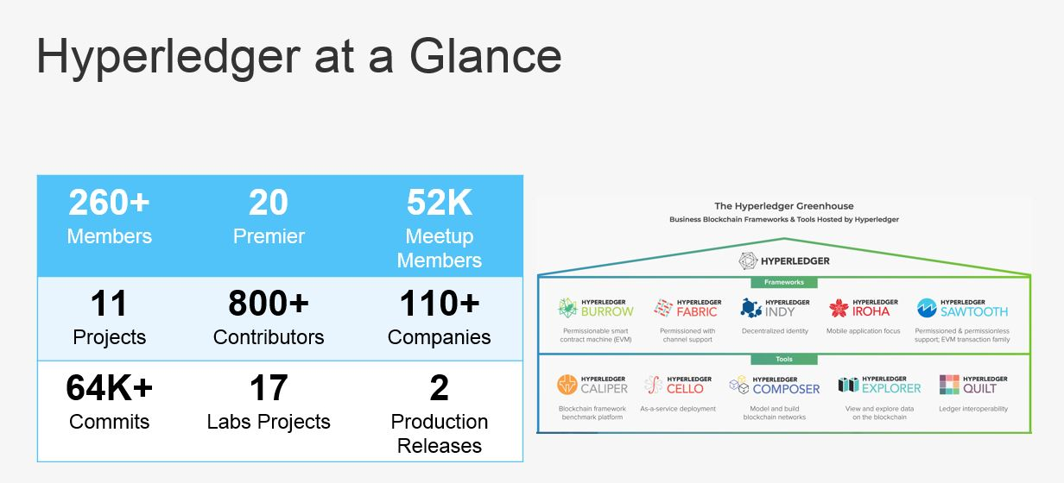

Slide 6
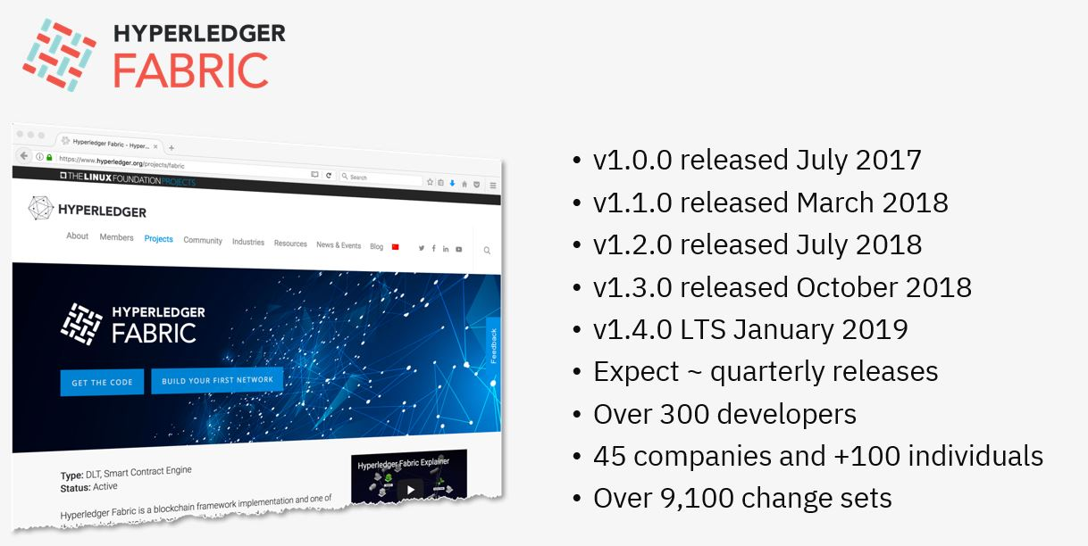

Slide 7
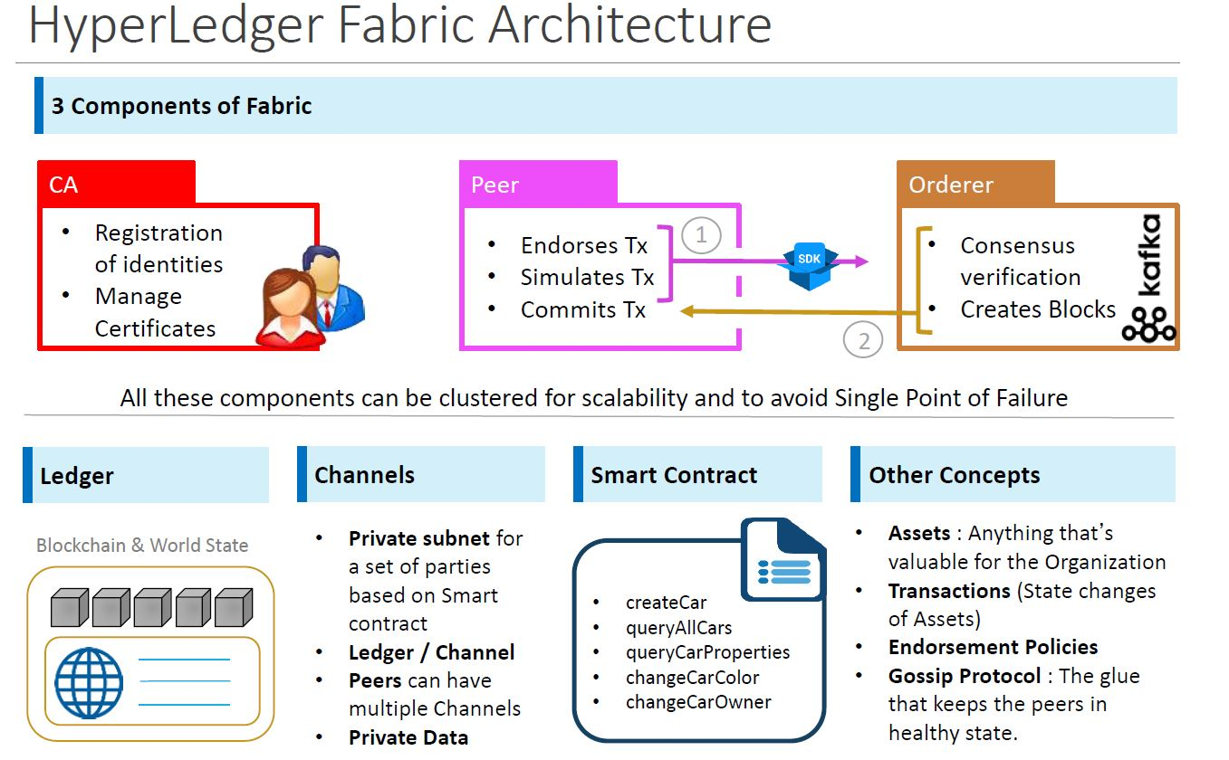

Slide 8
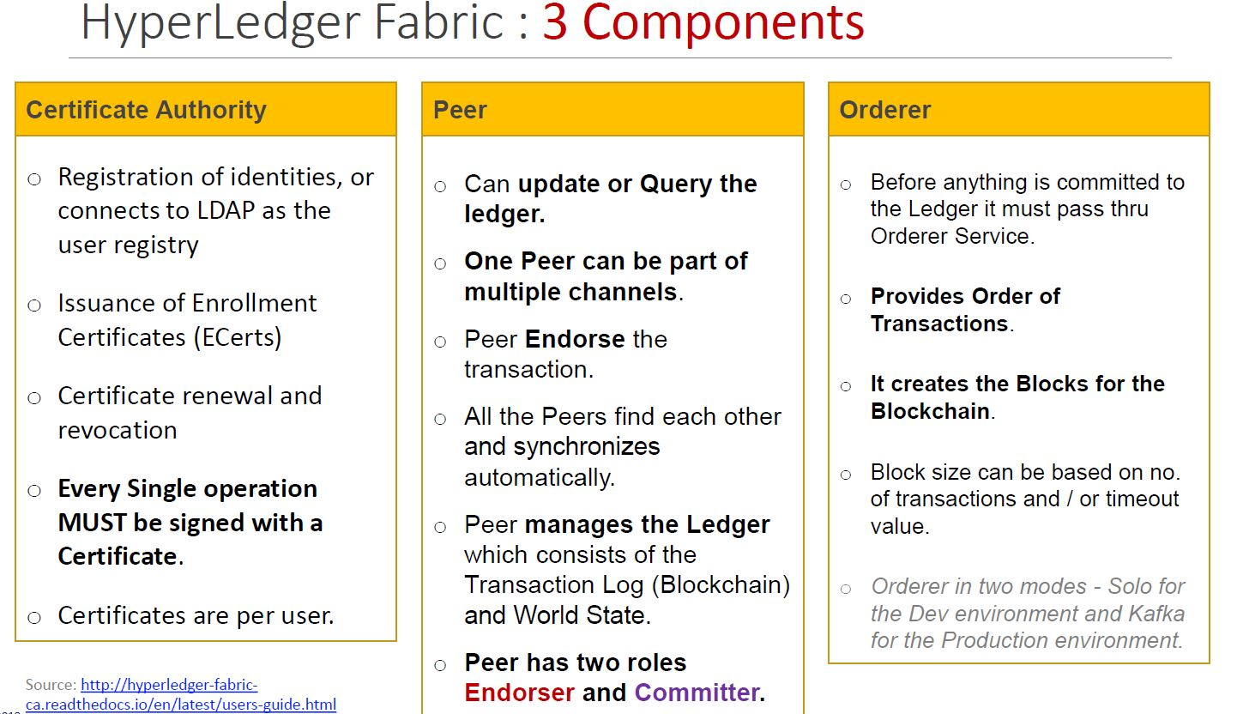

Slide 9
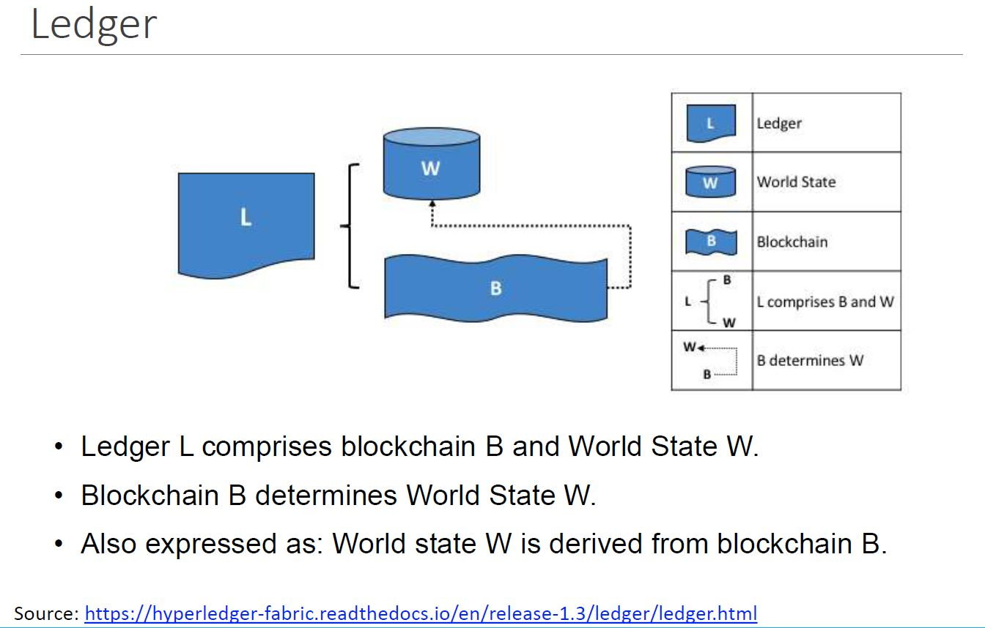

Slide 10
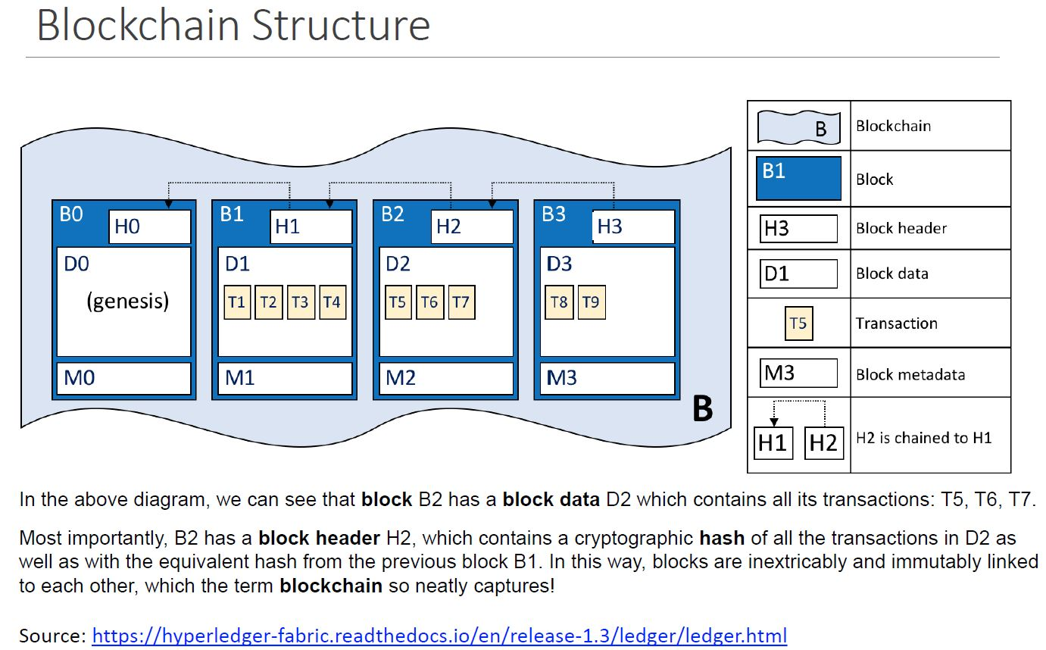

Slide 11
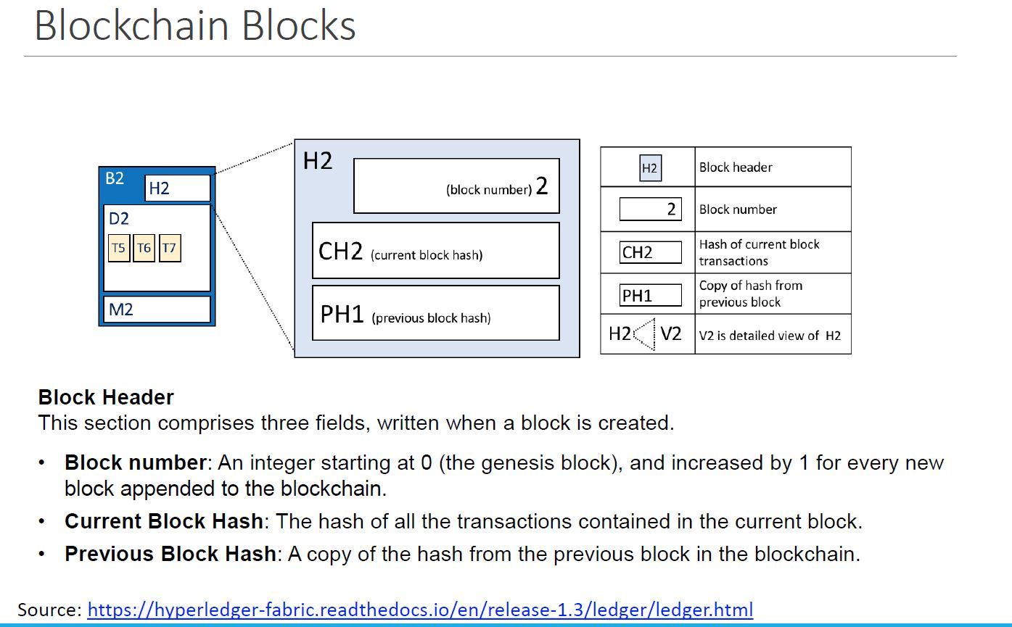

Slide 12
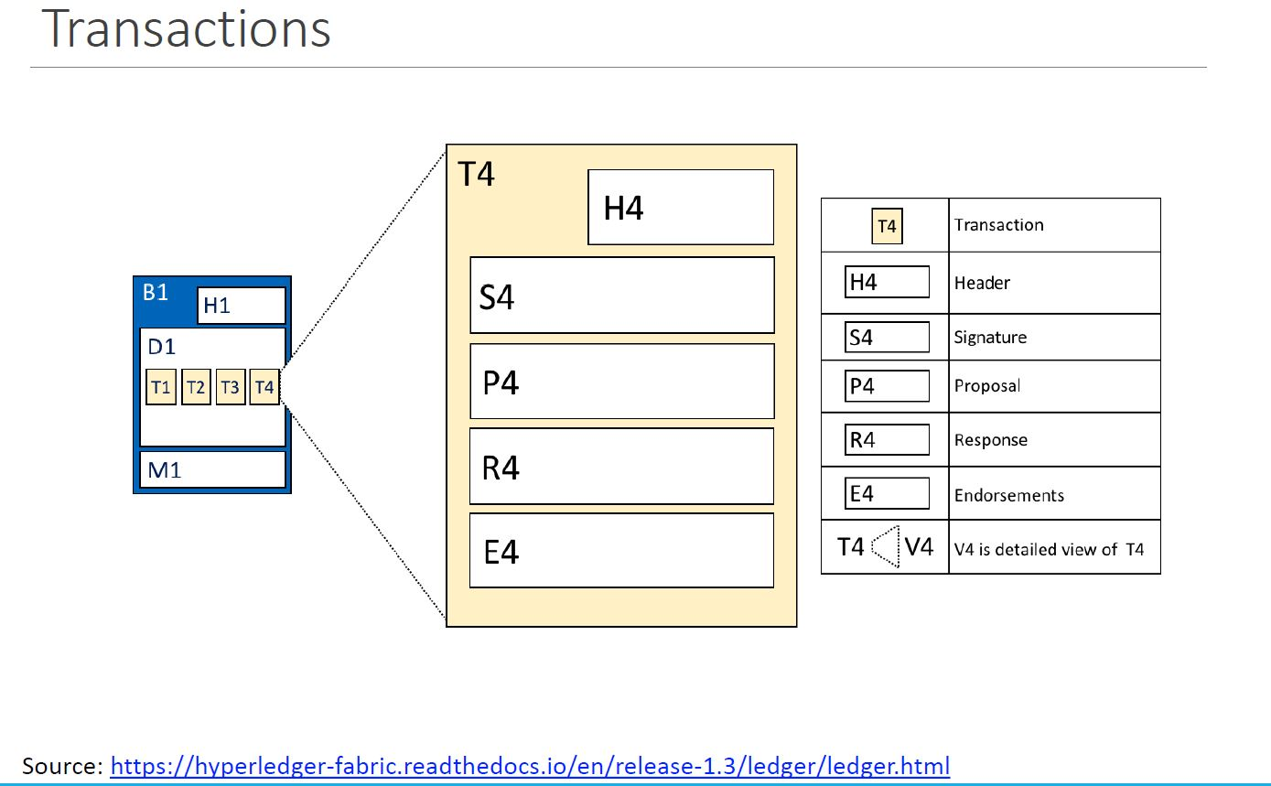

Slide 13
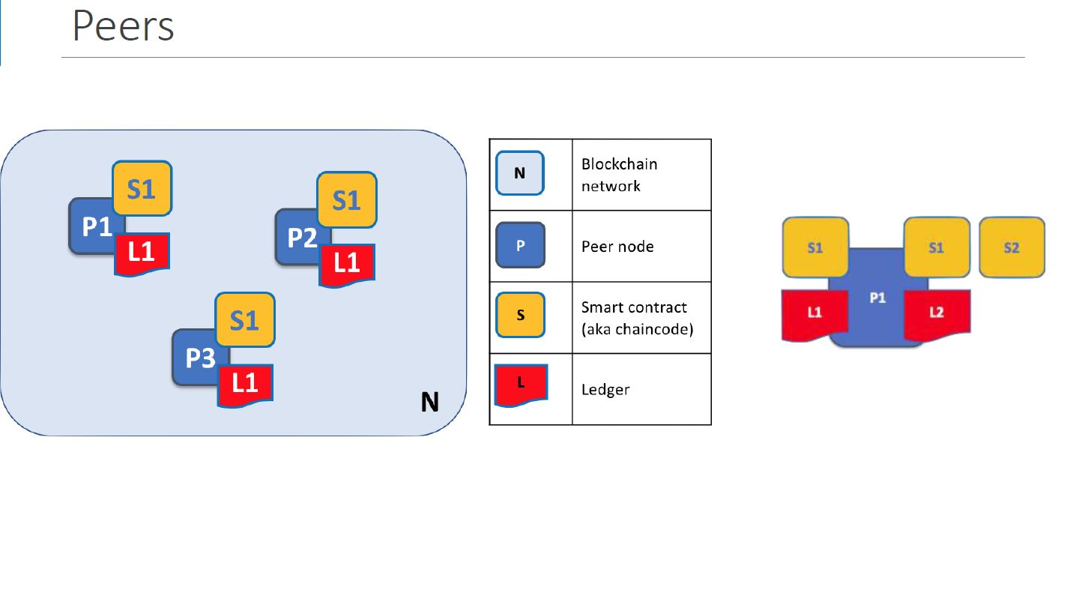

Slide 14
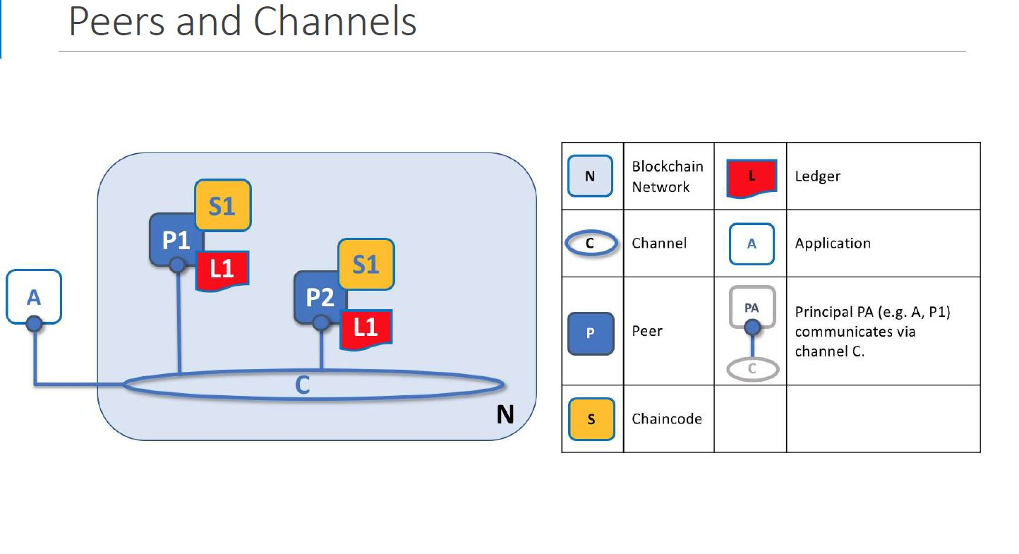

Slide 15
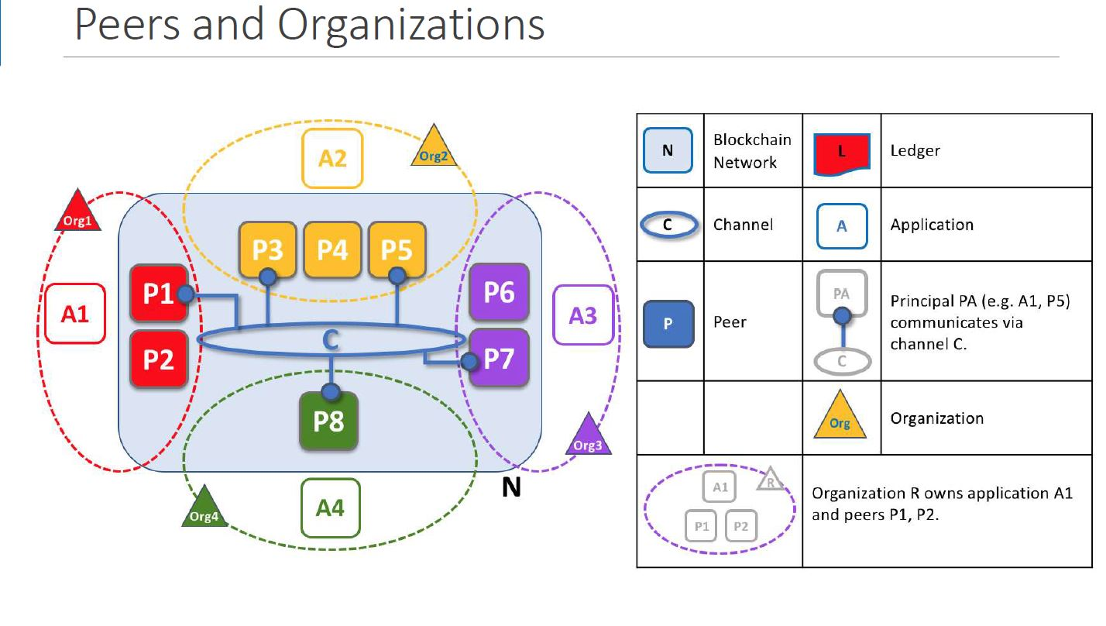

Slide 16
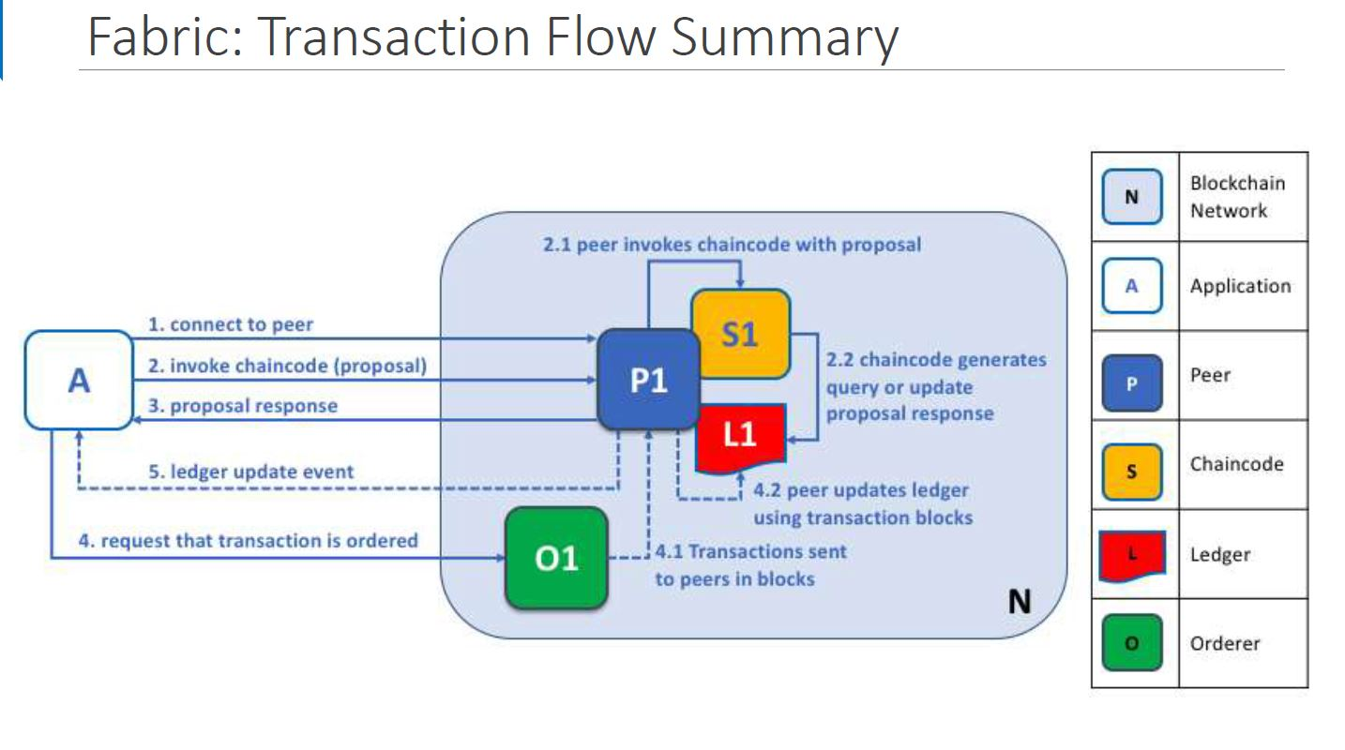

Slide 17
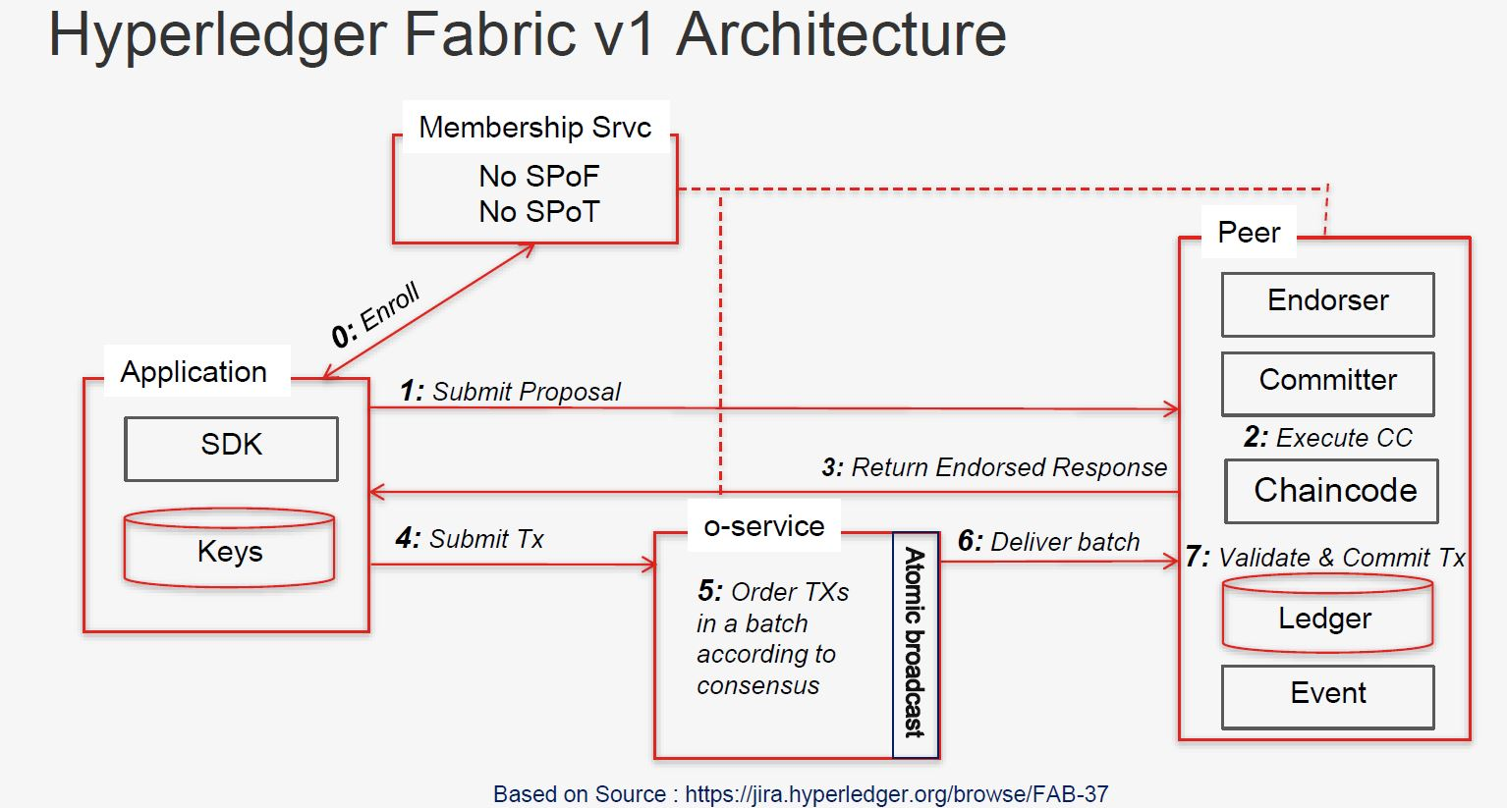

Slide 18
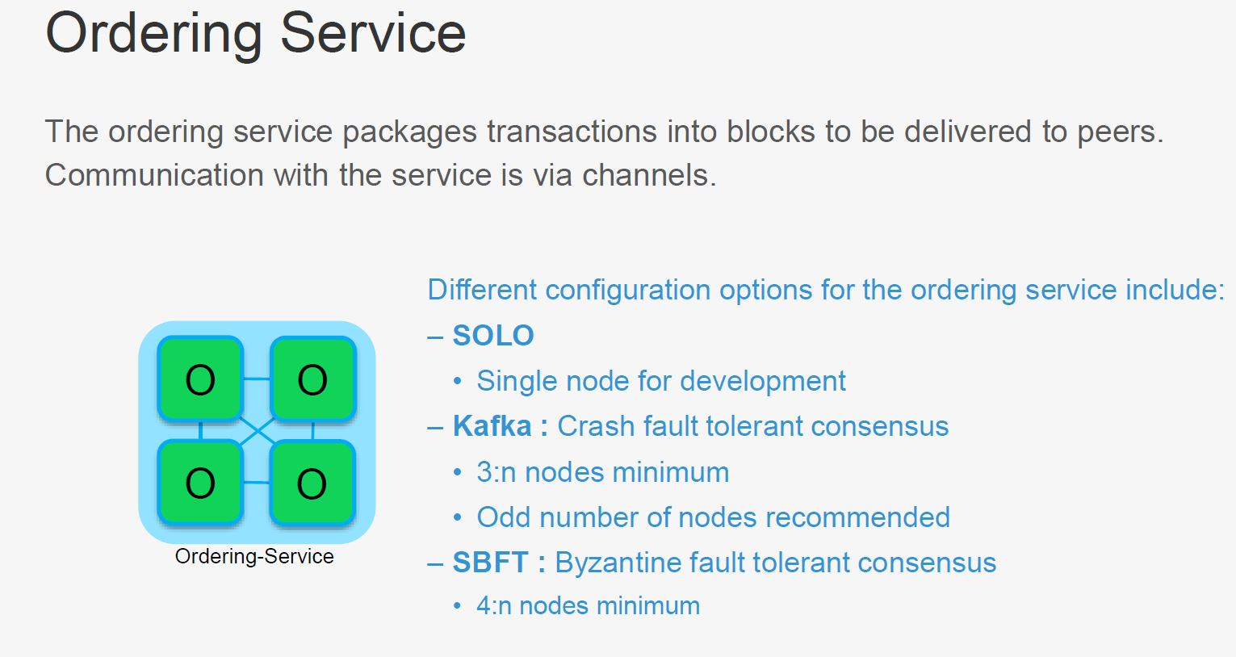

Slide 19
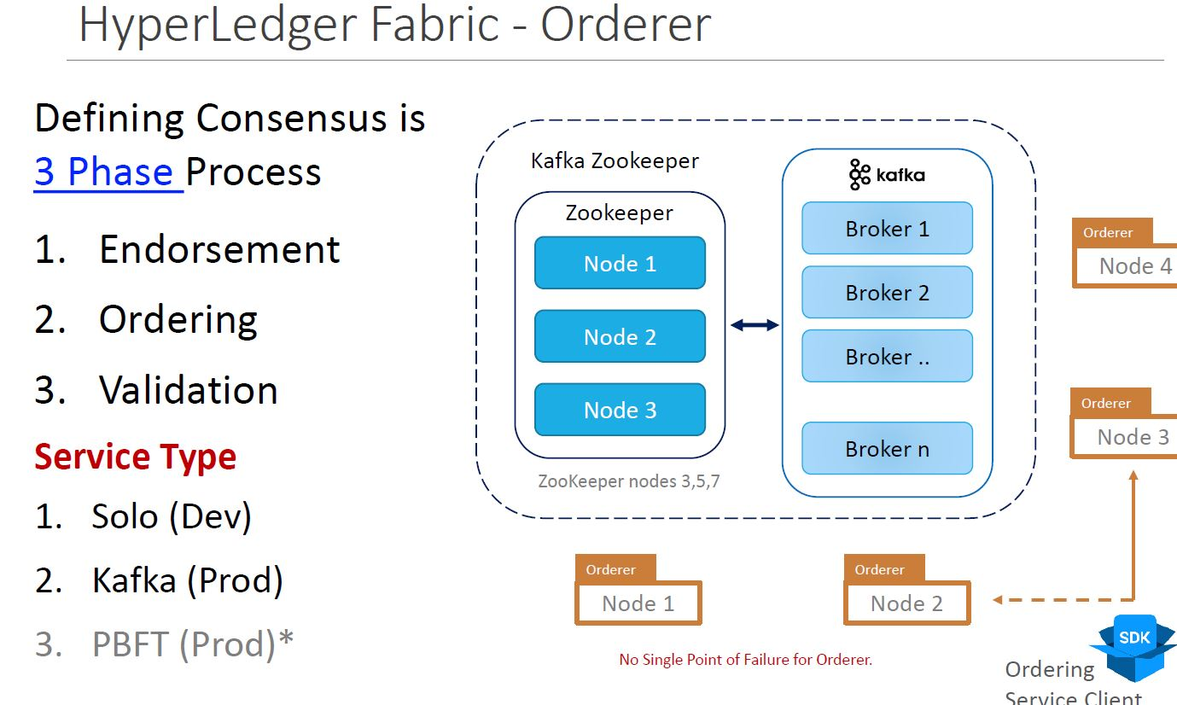

Slide 20
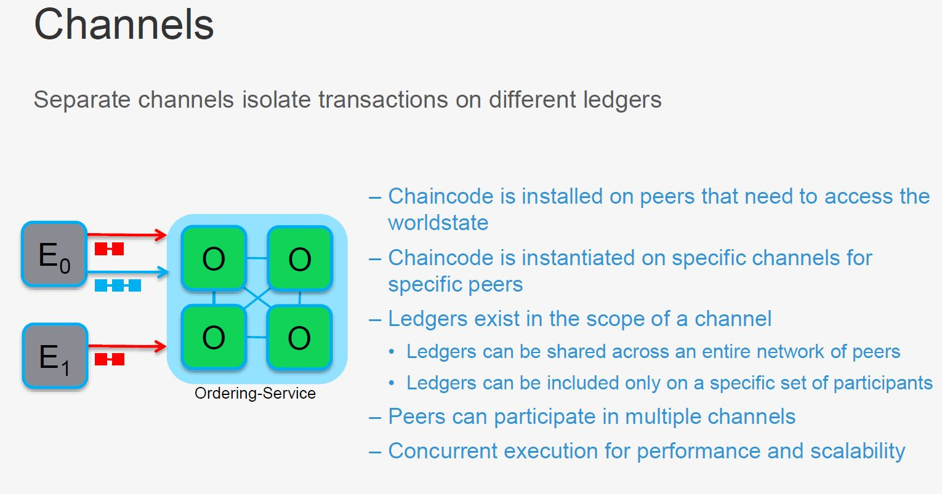

Slide 21
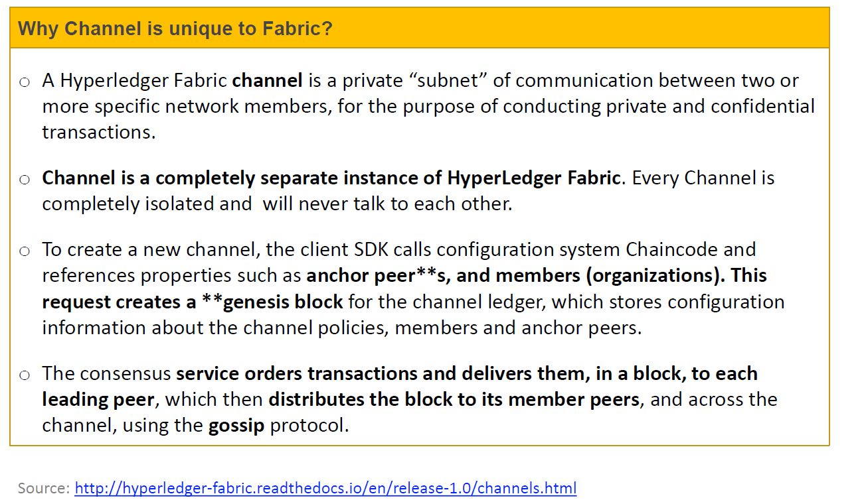

Slide 22
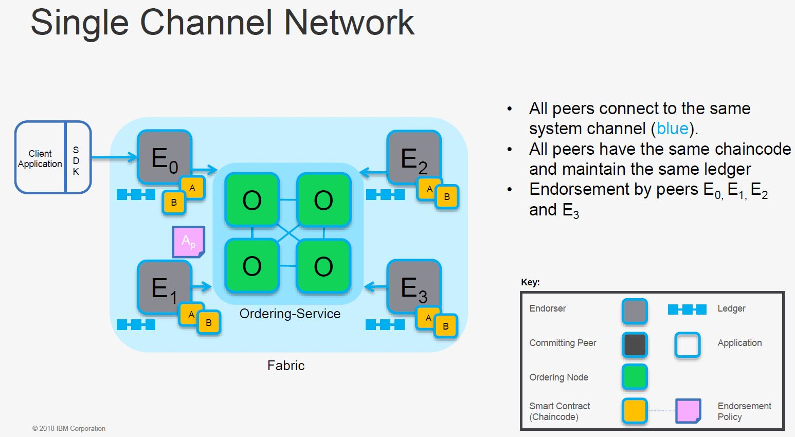

Slide 23
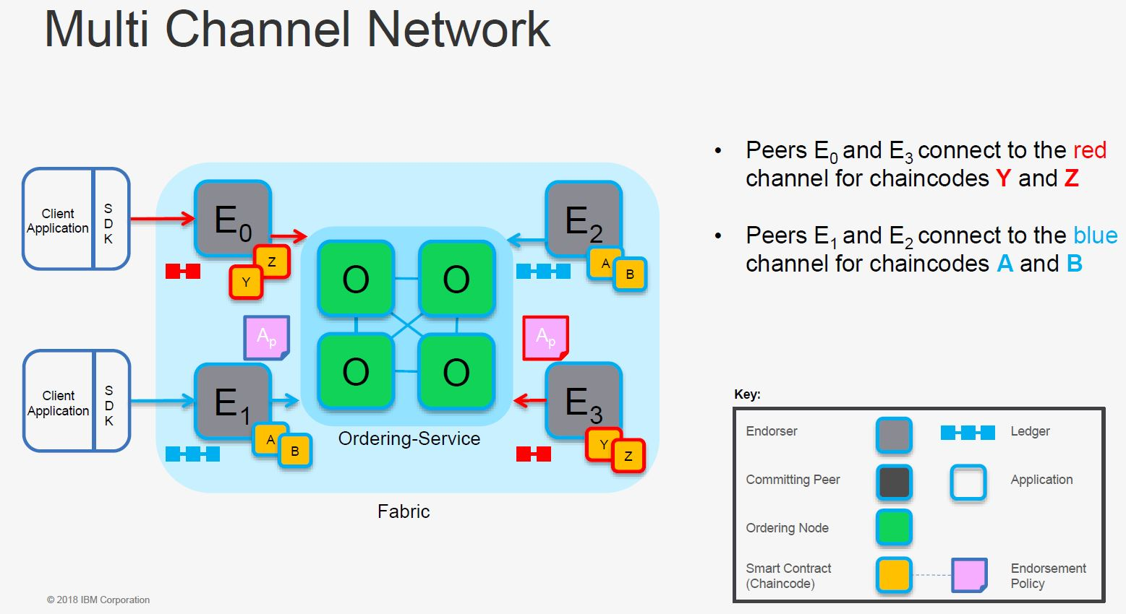

Slide 24
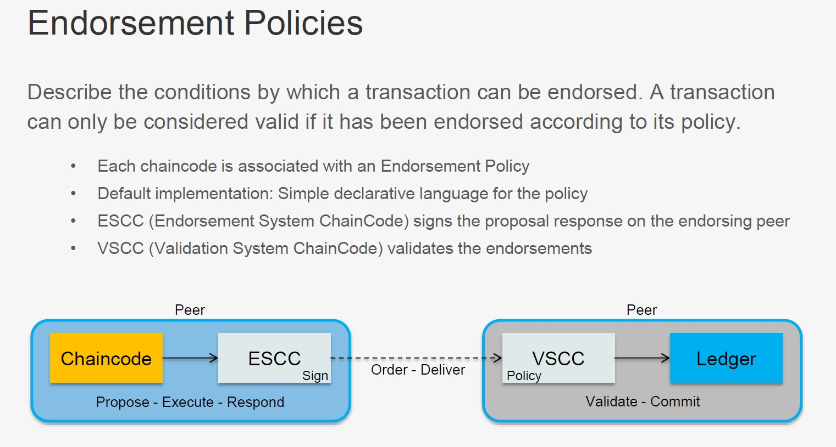

Slide 25
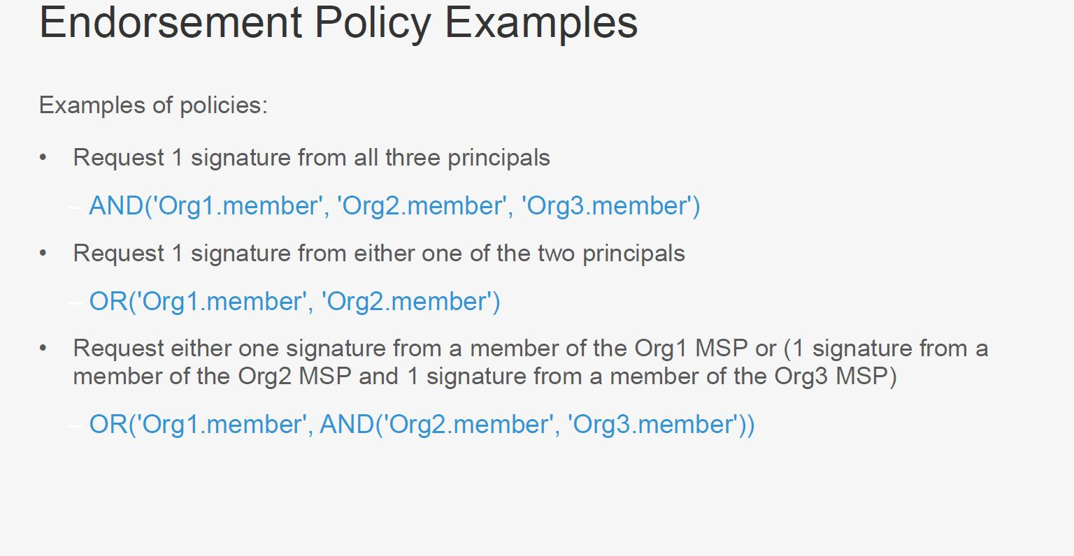

Slide 26
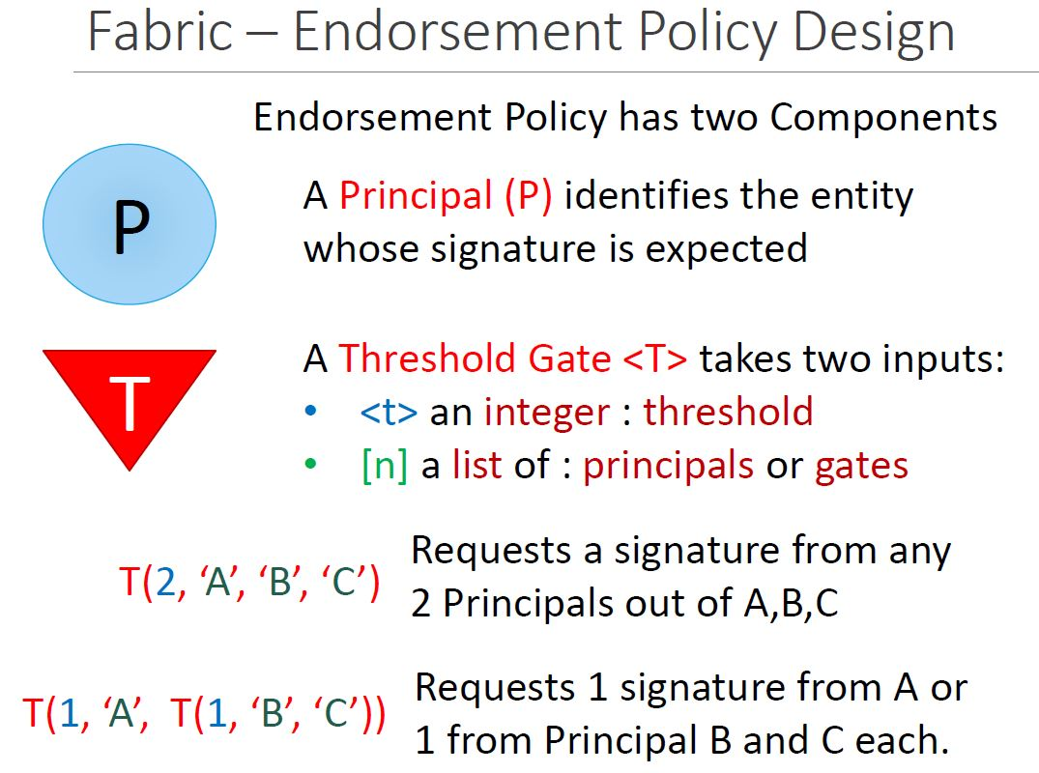

Slide 27
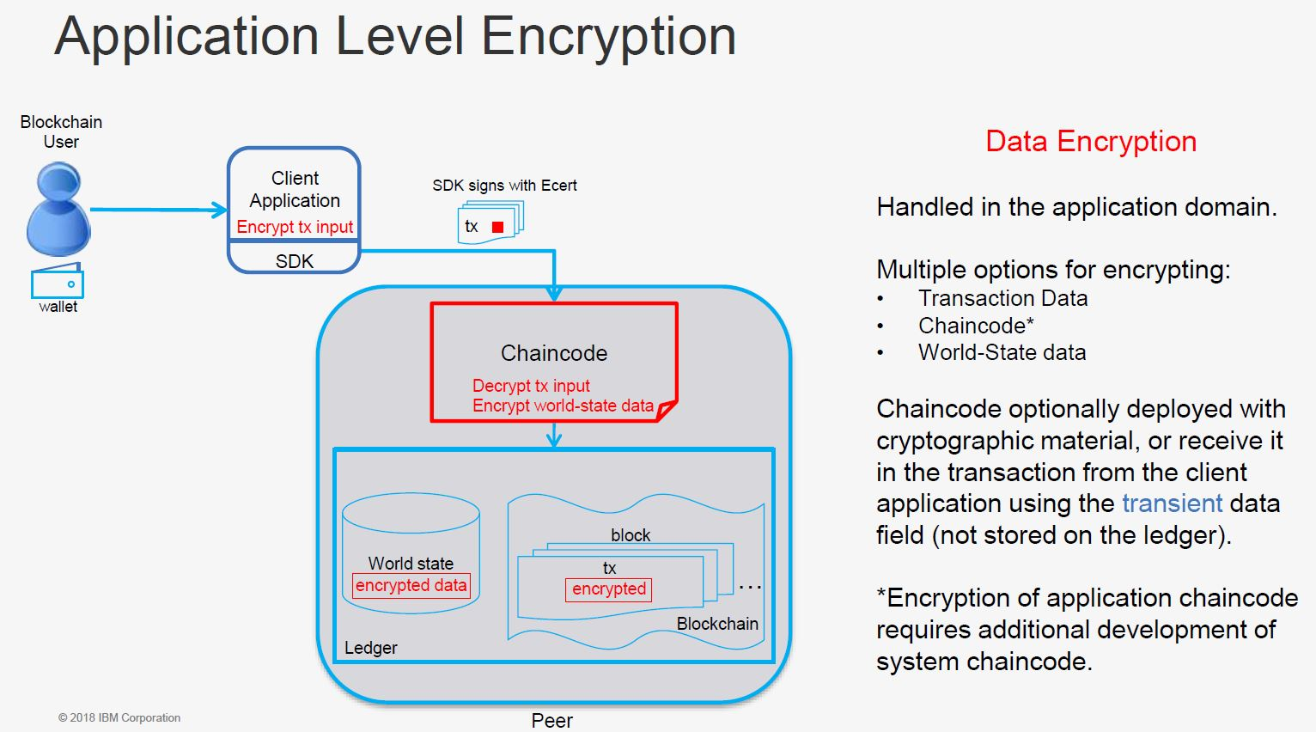

Slide 28
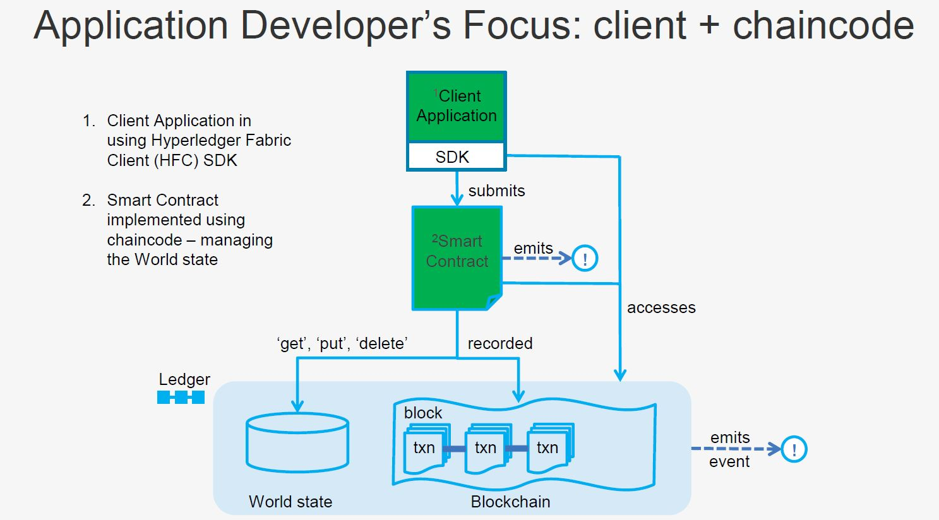

Slide 29
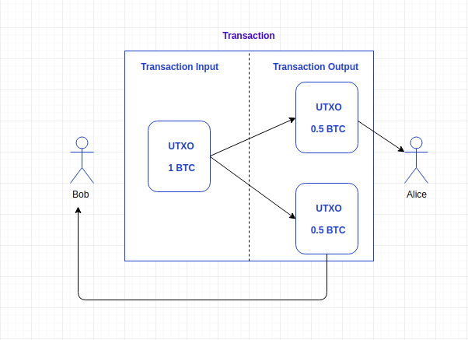
Notes:
UTXO is good for zero-knowledge capabilities to the token capabilities and UTXO-like structures are a very good fit for these types of cryptographic
circuits
We looked at the pure account-based model (ala Ethereum) but determined it was not a great fit especially when taking into consideration that we also plan
to add zero-knowledge capabilities to the token capabilities and UTXO-like structures are a very good fit for these types of cryptographic circuits

Slide 30
Different Blockchain States
Ethereum → Account Data
Hyperledger → Key-value Database Transaction log,
World State
Bitcoin → UTXO

Slide 31
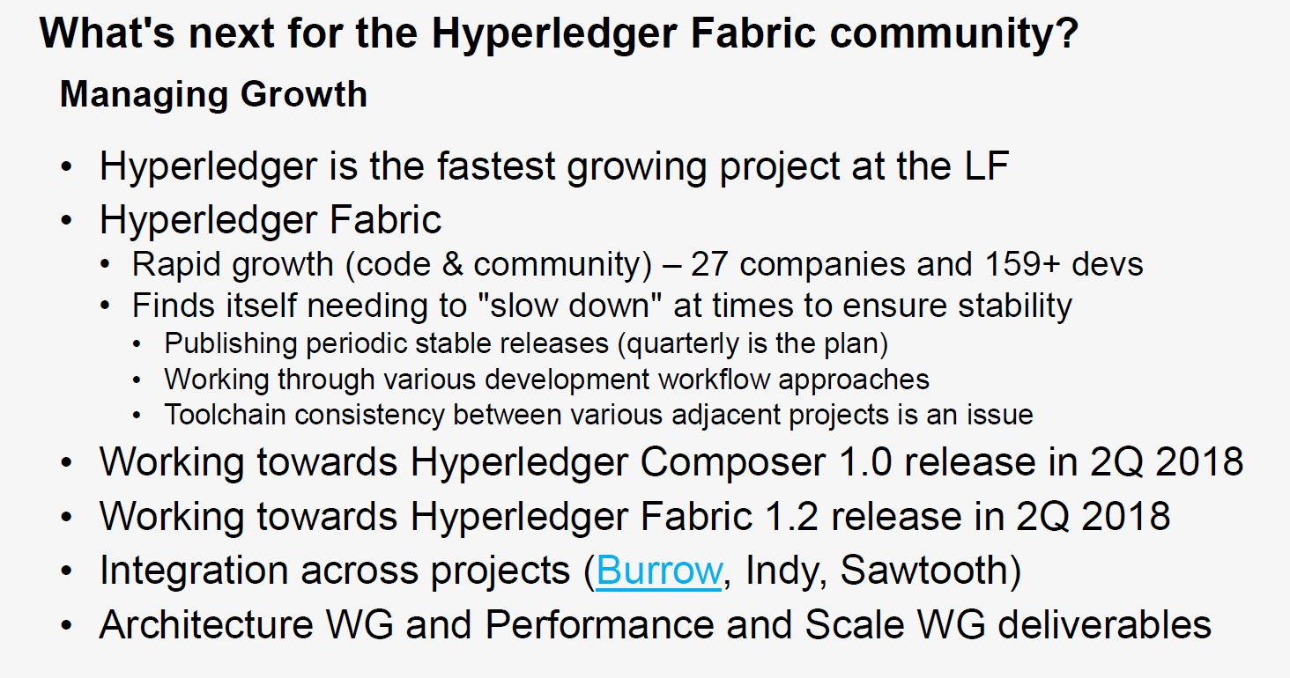

Slide 32
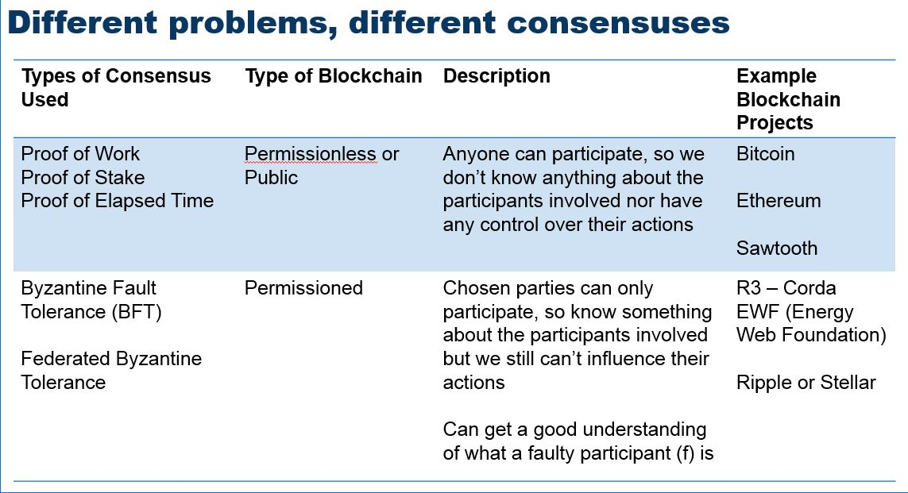

Slide 33
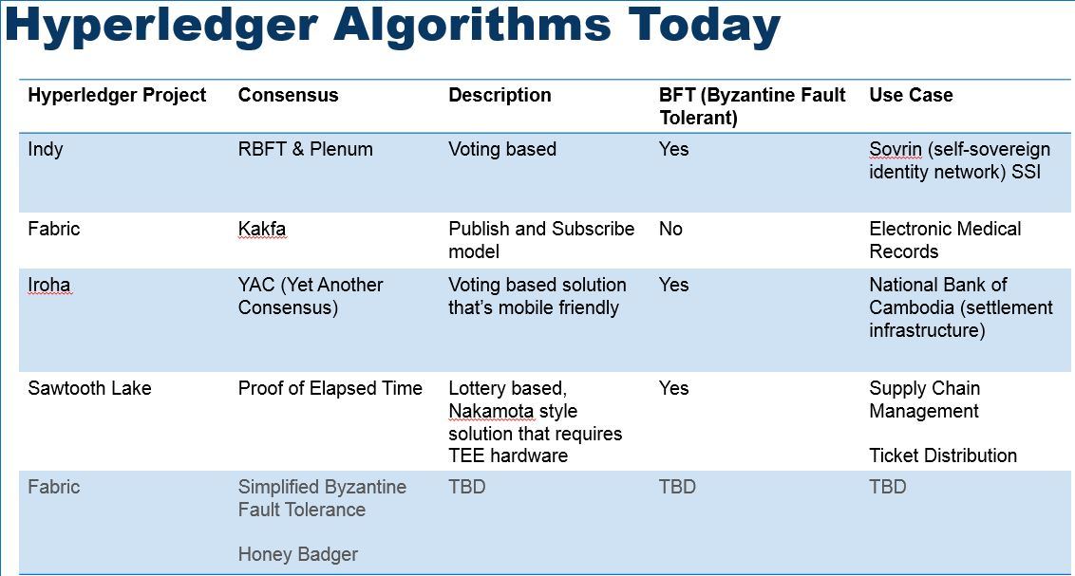
s

Slide 34
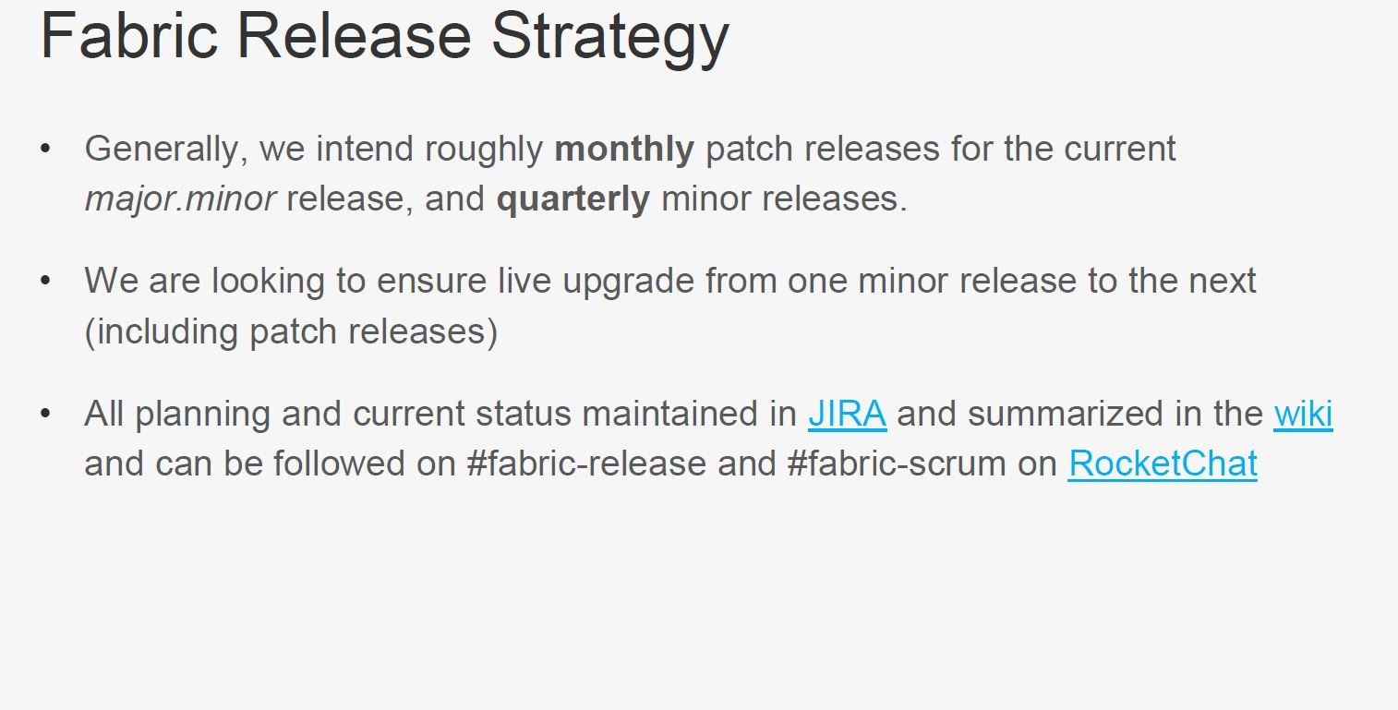

Slide 35
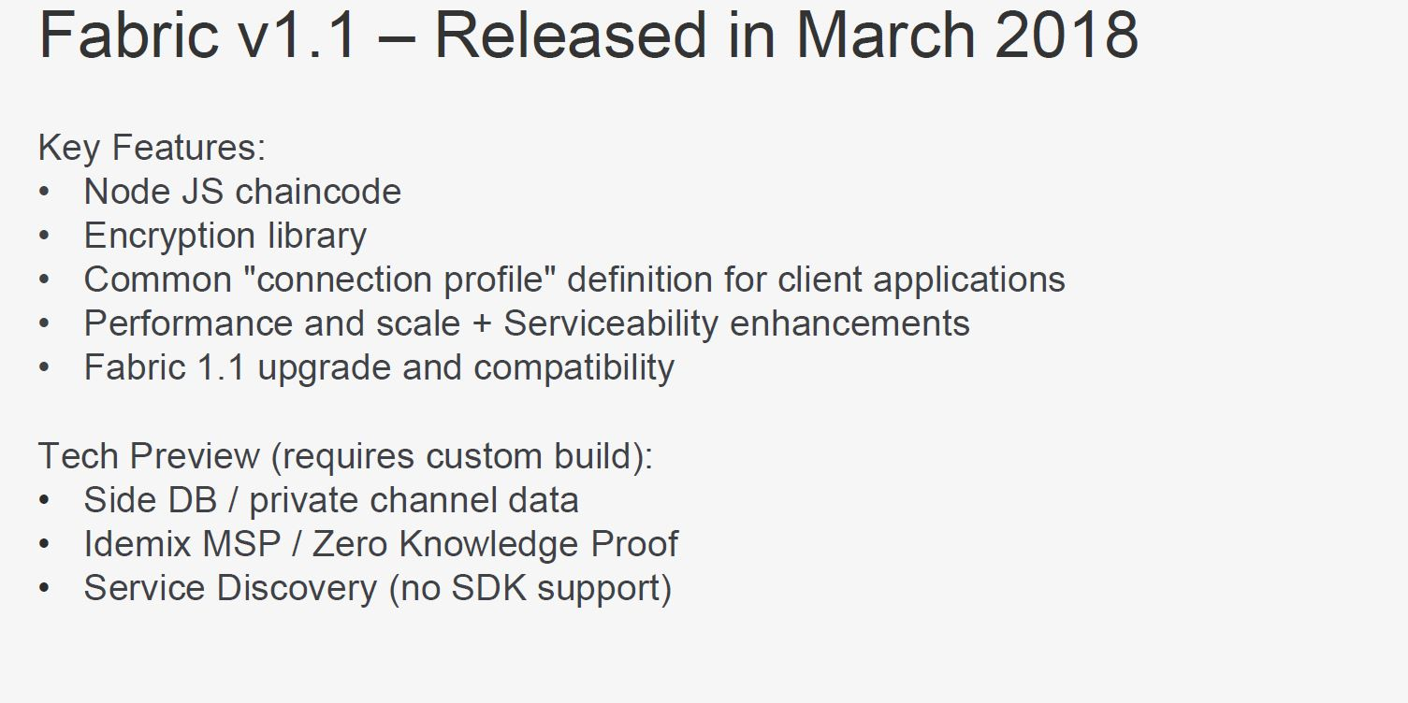

Slide 36
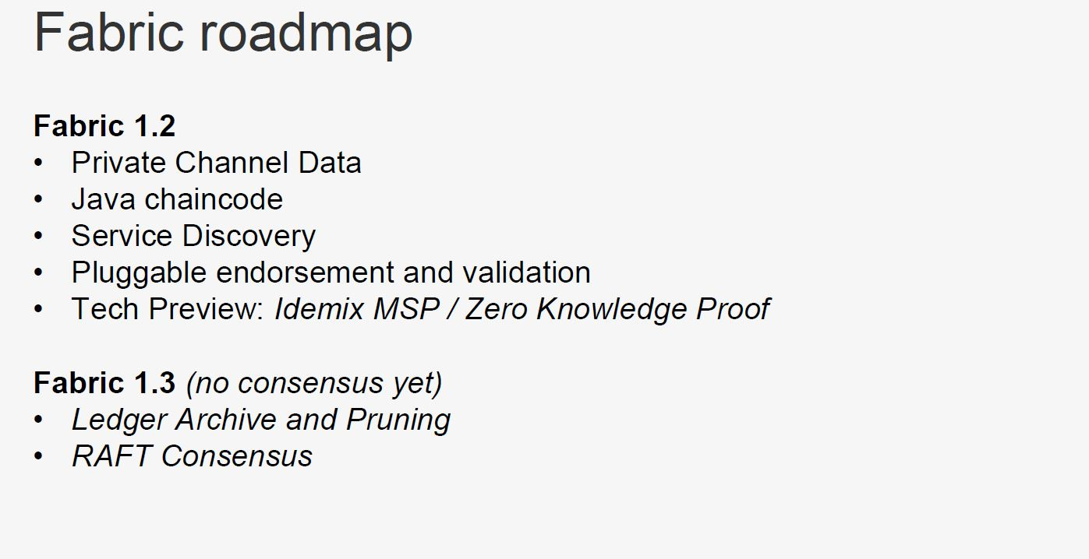

Slide 37
Thanks

